Slide 1

Gooseplayer A music player for DnD Enthusiasts & Local Music Server Streaming
Joshua Anderson
&
Camillus Settanni

Slide 2
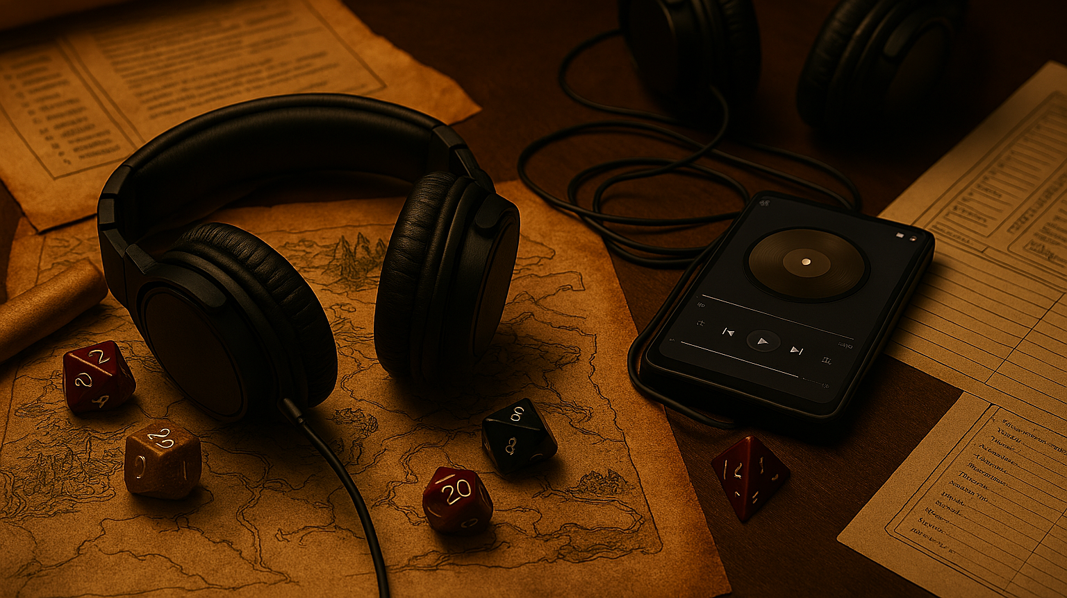
What is GoosePlayer?
GoosePlayer is a Windows desktop application that allows for multiple music tracks to be played in conjunction with each other, allowing for a much more immersive environment when playing table-top games such as DnD. However, that is not the only feature of this program. GoosePlayer also allows for connection to a remote music server giving users the ability to stream their audio remotely through the player.

Slide 3
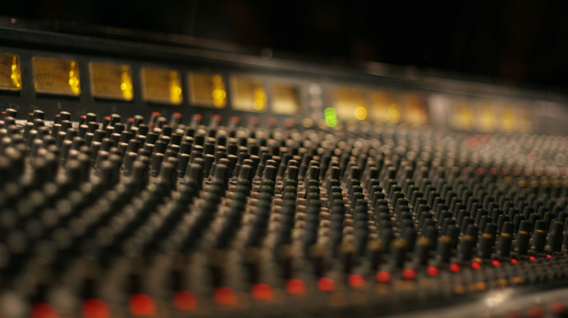
Why Gooseplayer?
This music player was born out of a mix of reasons.
Desired to code an advanced desktop application for Windows that implemented concepts such as queuing for files and used advanced coding tools and features available in Java
Lack of music players available that were capable of simultaneously playing multiple tracks for DnD sessions
Wanted to link an online music server with the application, demonstrating networking concepts such as the client-server architecture

Slide 4
Requirements
Core Features
Playback Modes
View modes:
User Experience
Technical

Slide 5
GoosePlayer System Requirements & Features
Core Features
Play, Pause, Stop Skip (Next) / Previous Seek (clickable progress bar) Volume control Clear queue Support MP3, WAV, FLAC audio formats Multiple independent player instances Online streaming
Playback Modes
Repeat Off / Repeat One / Repeat All Shuffle Queue & Playlist Management
Drag-and-drop files & folders into queue Remove selected song(s)
Load / delete / rename playlists
“Add to queue” vs “Play now” context menu
View modes:
Display song title, artist, album, year, genre Show embedded or folder album art Default “missing art” placeholder
User Experience Optional Visual themes Remember window size/position and last playlist in queue
Technical
Windows desktop application

Slide 6
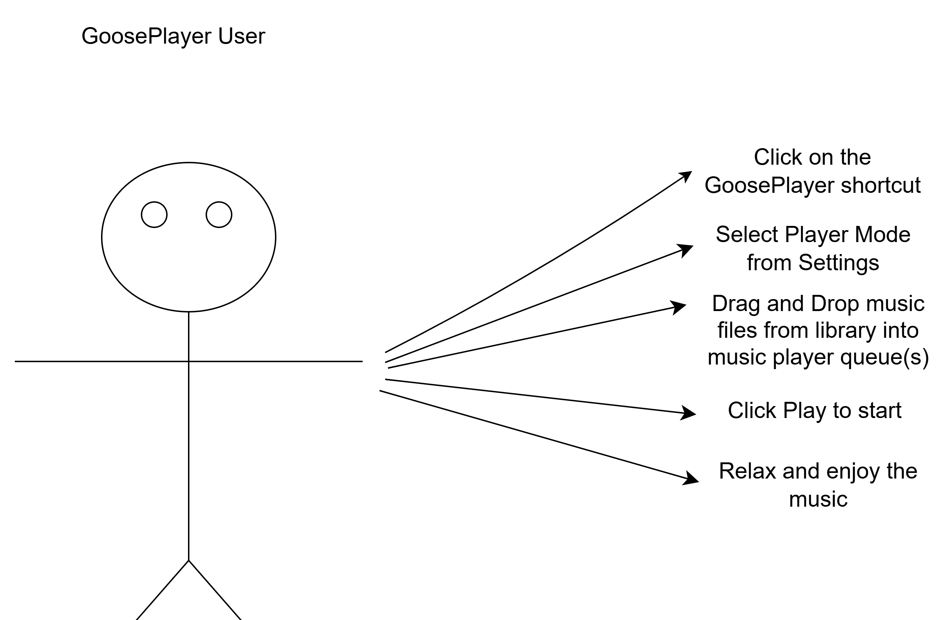
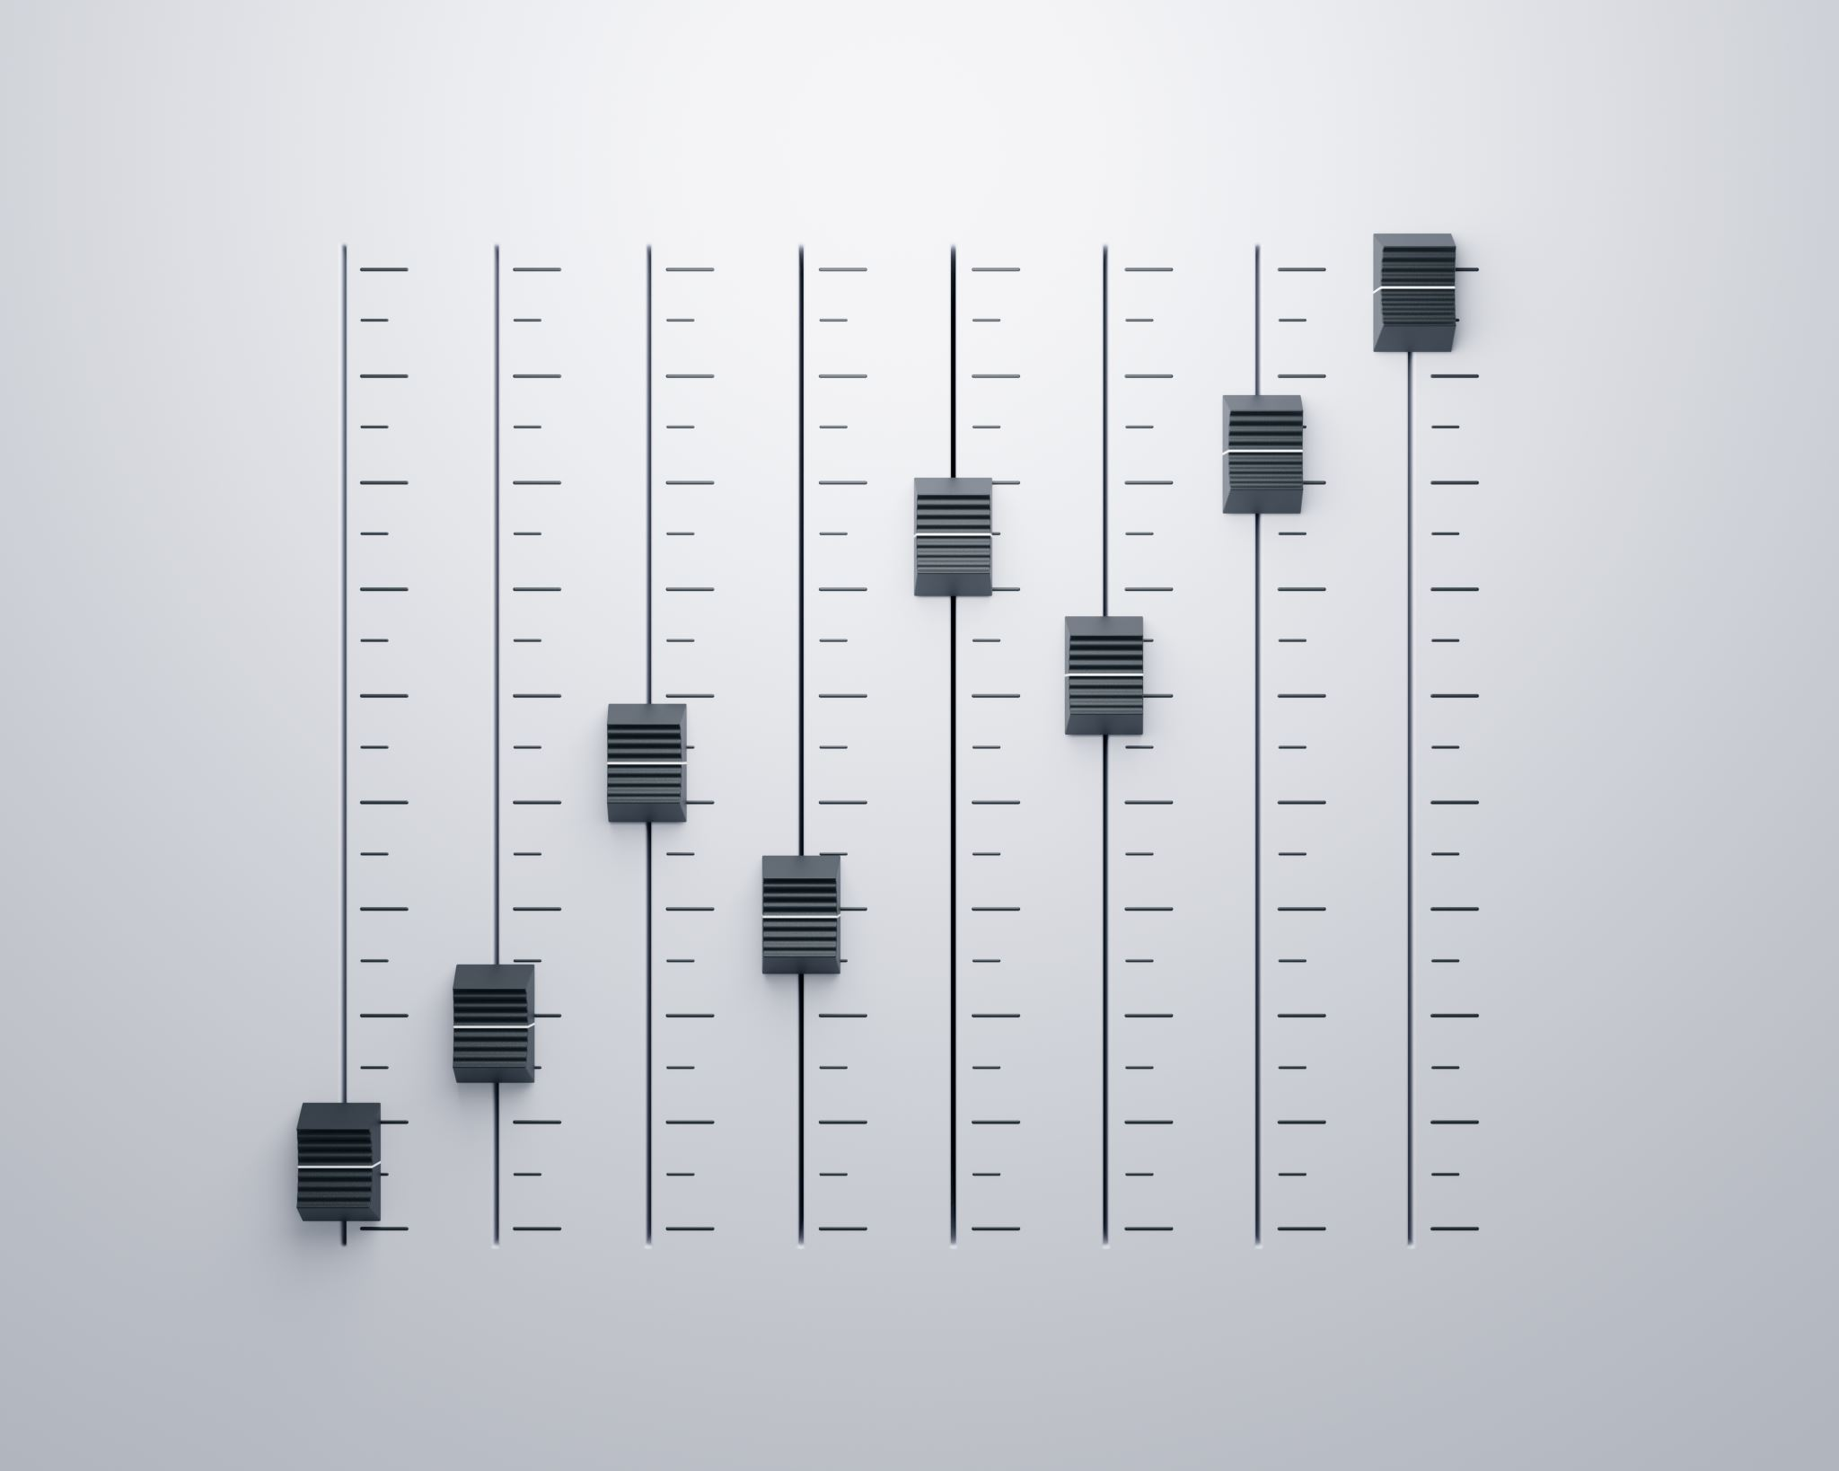
User Experience Requirements
The typical user of this application should be able to click on the shortcut to open the player, choose the mode of the player they wish to utilize under settings, and drag and drop music files they wish to play into the queue for the player or type in the address for the online music stream.

Slide 7
Implemetation

Slide 8

Tools/Technology Used for this Project
Language
Project Management/ Communication
Version Control
Grok
Copilot
IDE
Build Tool
Java
Apache Maven
VS Code
Git
Github
Discord
Jira
AI assistance
ChatGPT
Diagram Software
Draw.io

Slide 9
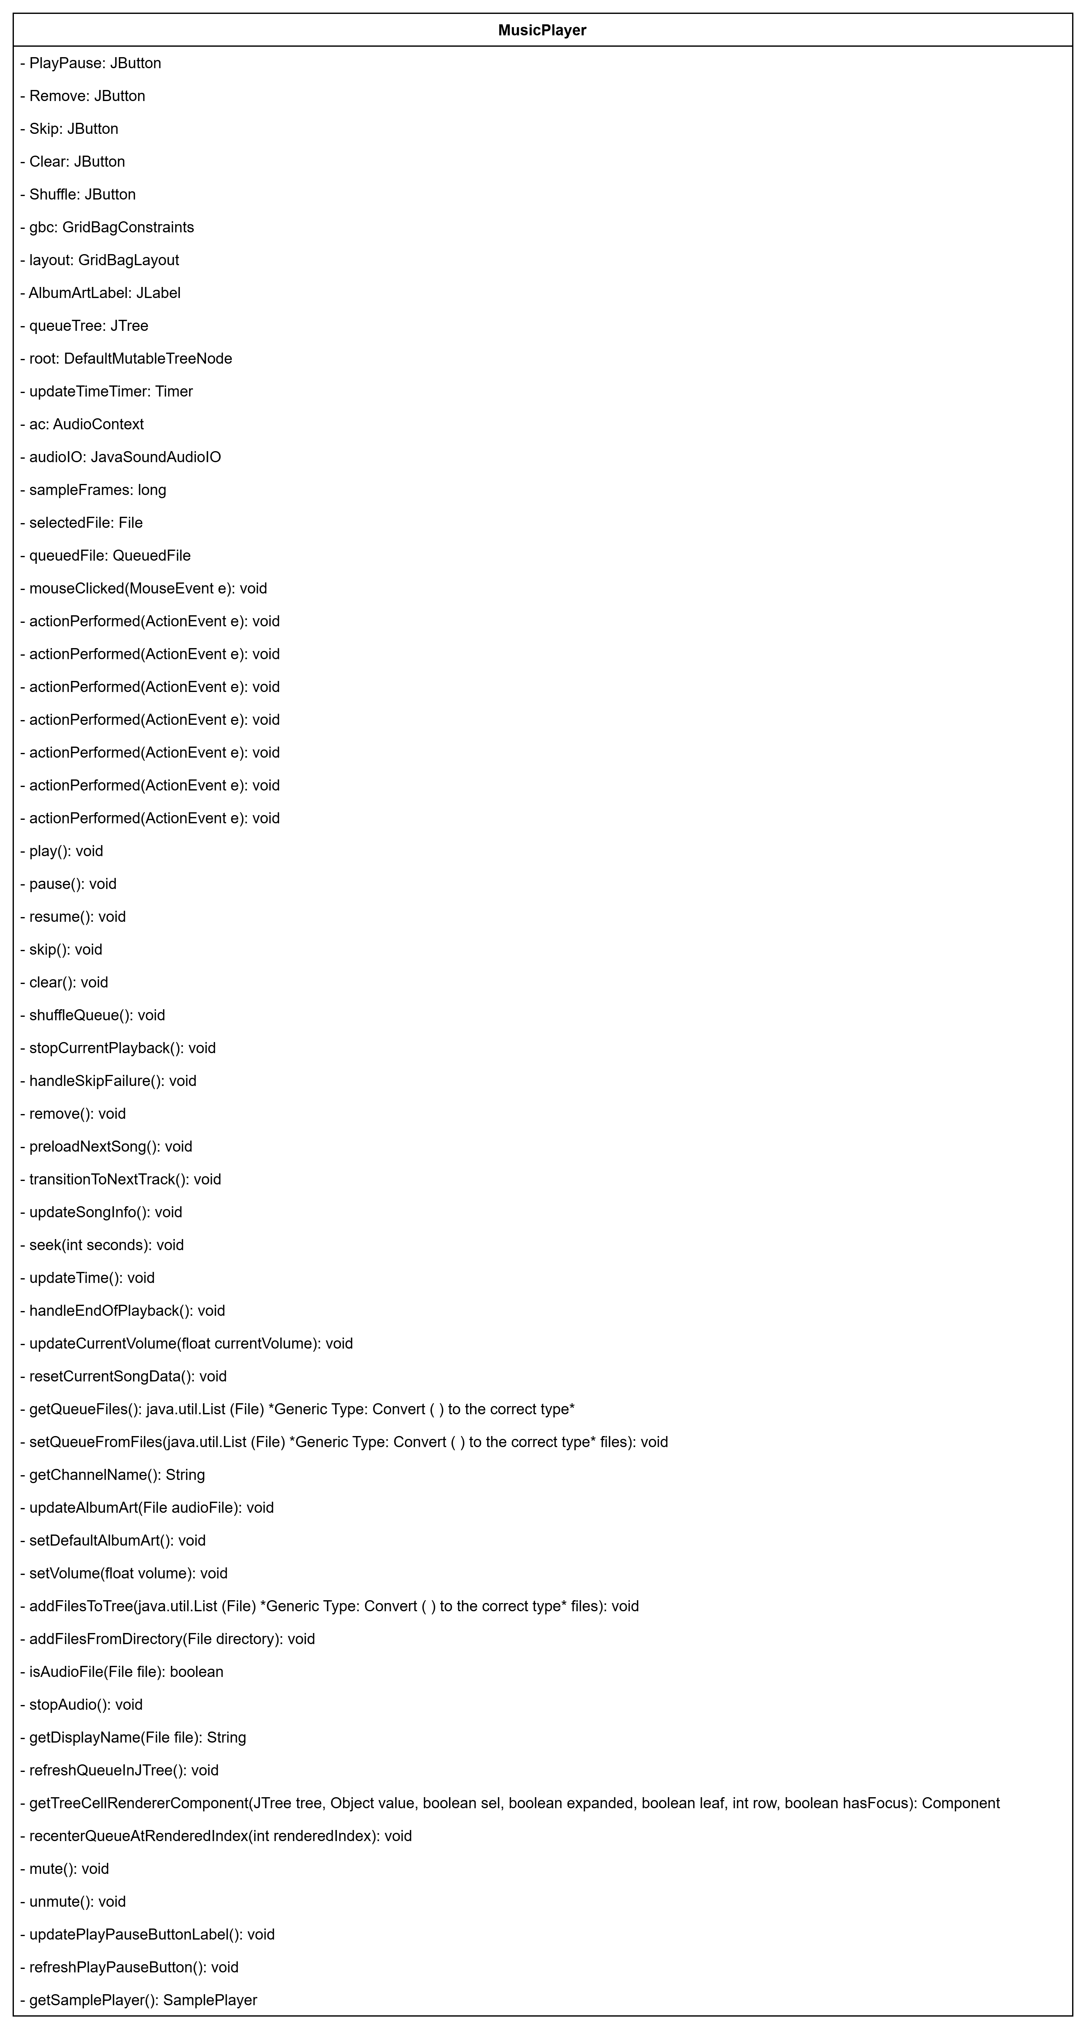
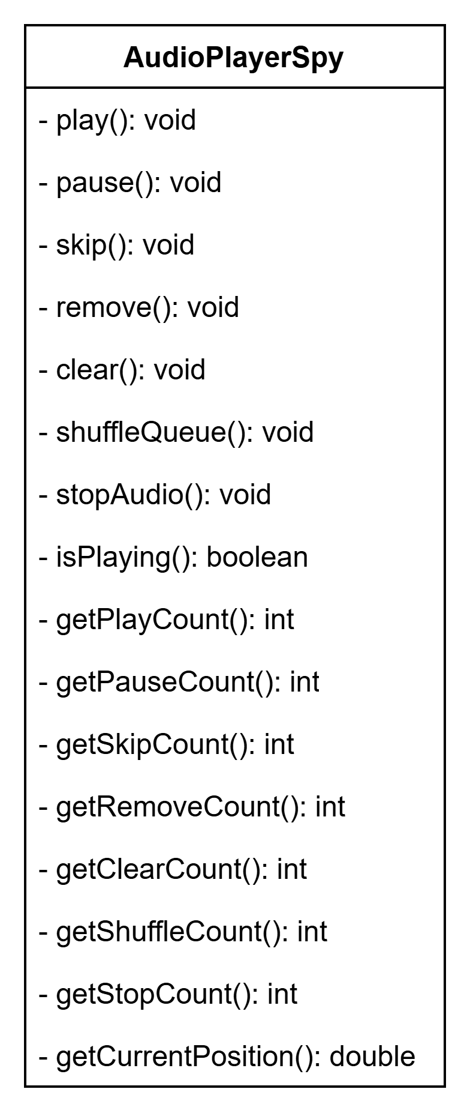
Analysis – UML Diagram

Slide 10
Process Model
Incremental Model

Slide 11
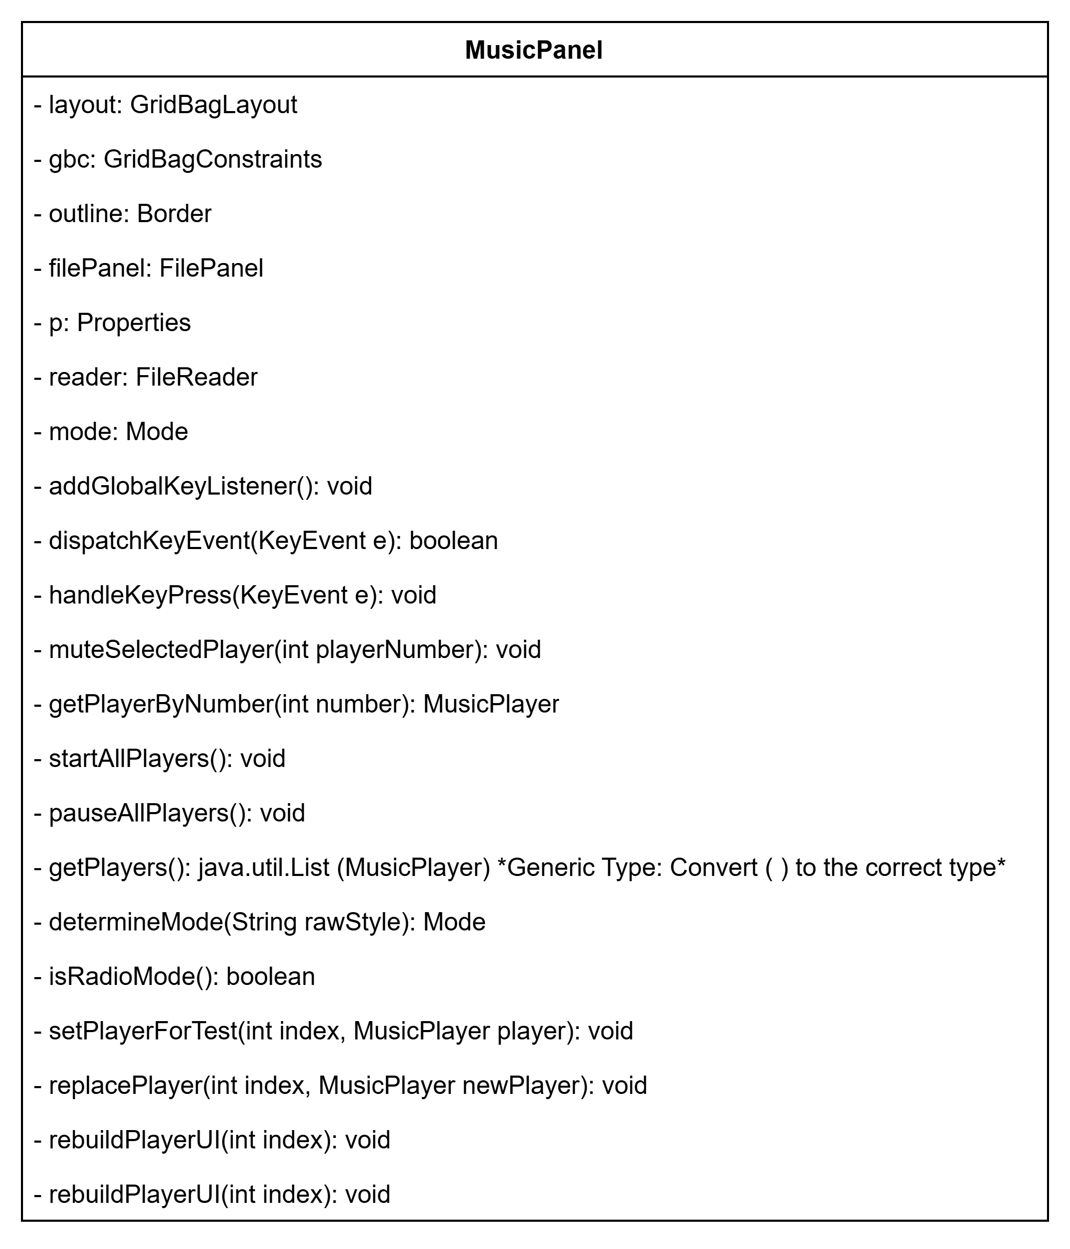
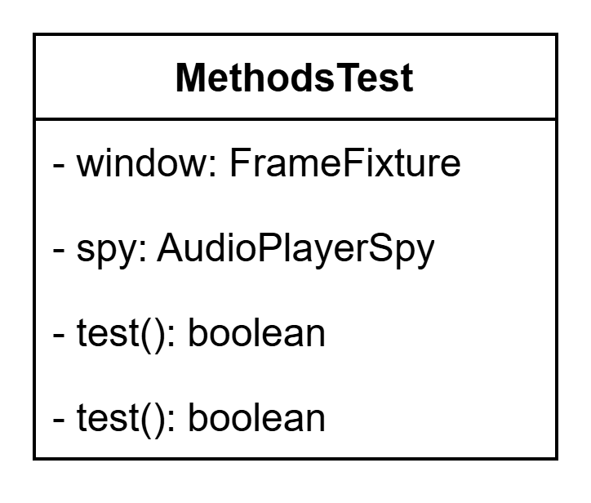
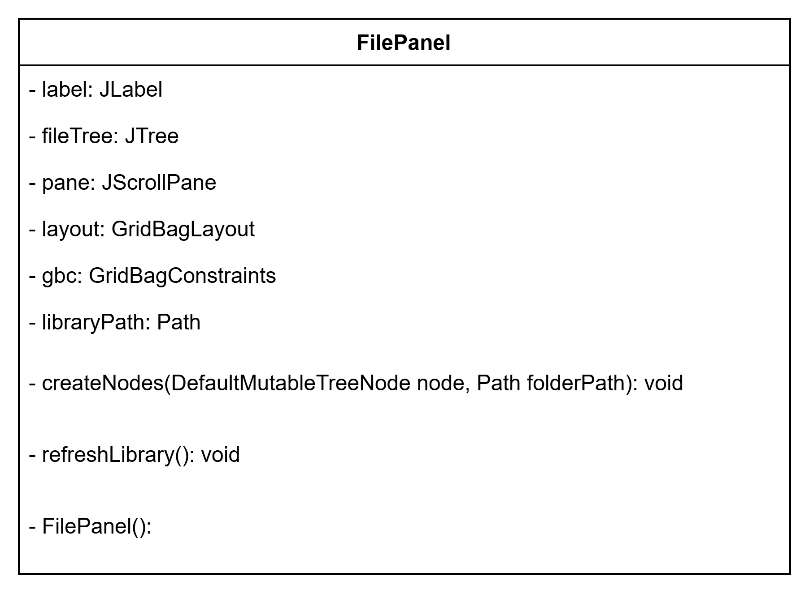
More Diagrams

Slide 12
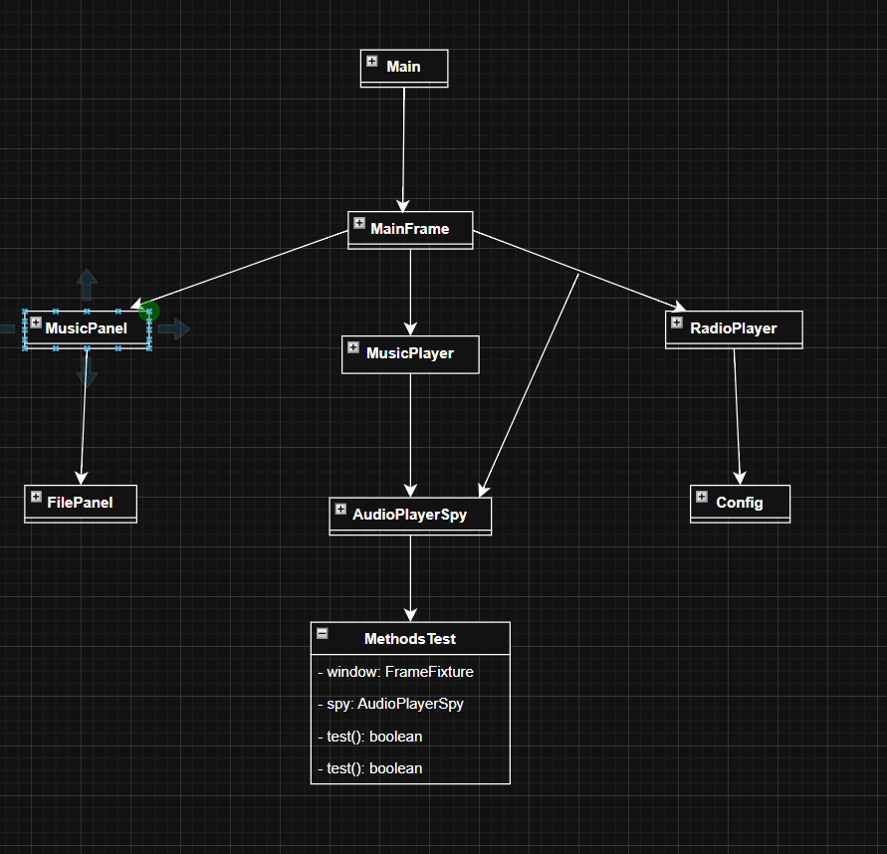
Hierarchical Design

Slide 13

Testing

Slide 14
Testing Tools Used
JUnit 5
Main assertion and testing framework
Mockito
Mocking framework for Java
AssertJ swing (tokyo.northside fork)
UI testing component

Slide 15
Test Cases
Mix of manual and automated regression testing
Regression Testing
- Methods being called correctly
- Correctly functioning when called
- UI interactions
- Queue interactions

Slide 16

Demo

Slide 17
Issues Overcome with this Project
Plugin Support
Testing Software

Slide 18

Future Features for Implementation

Slide 19

Questions?

